Slide 1
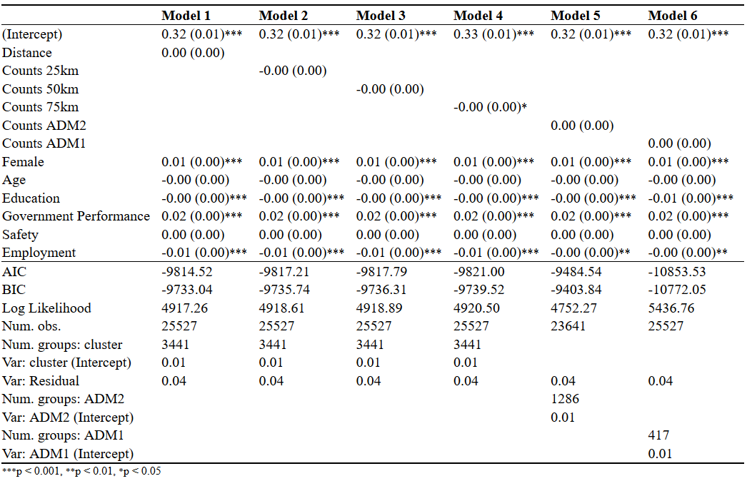
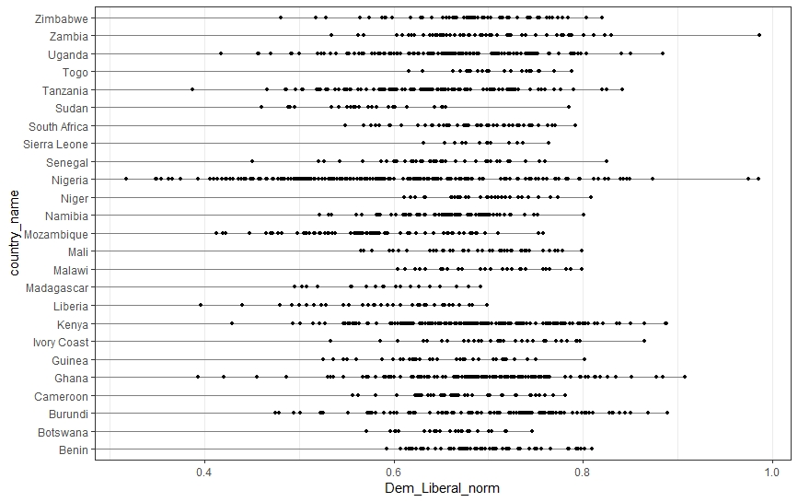
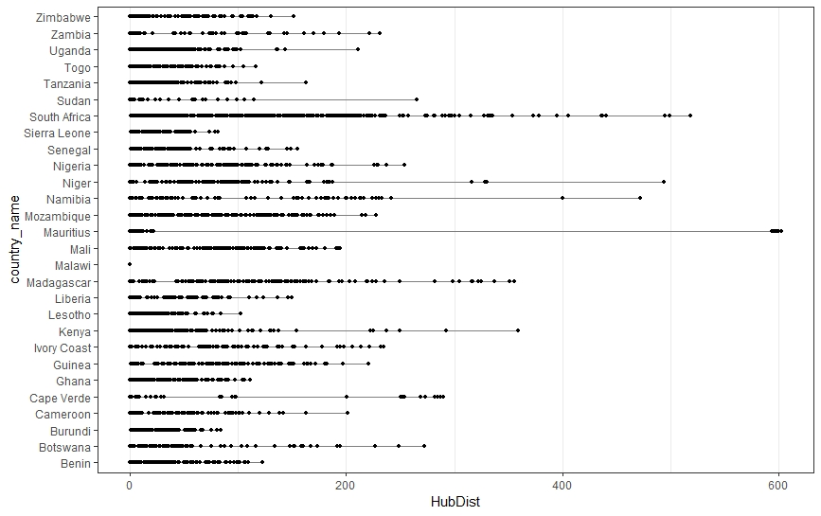
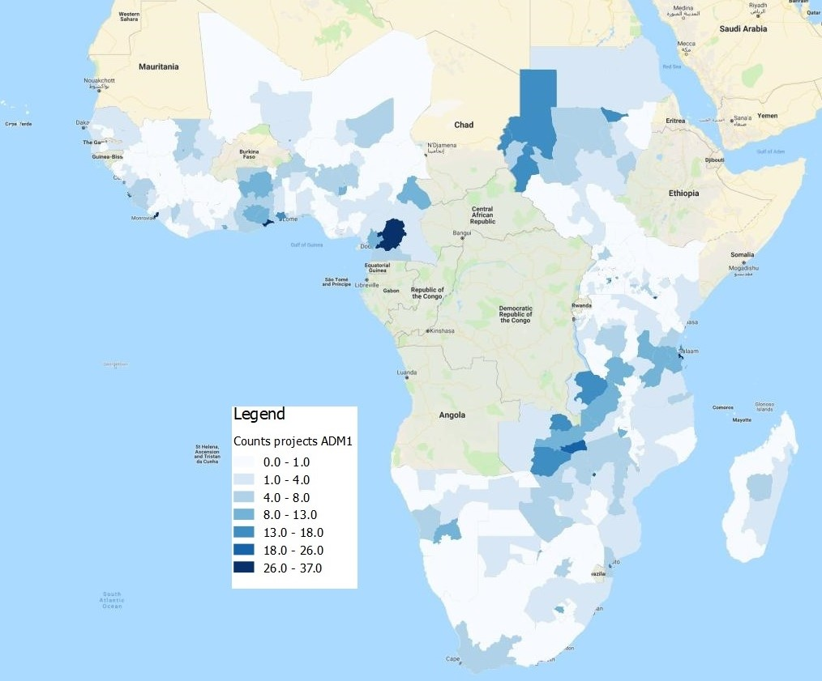
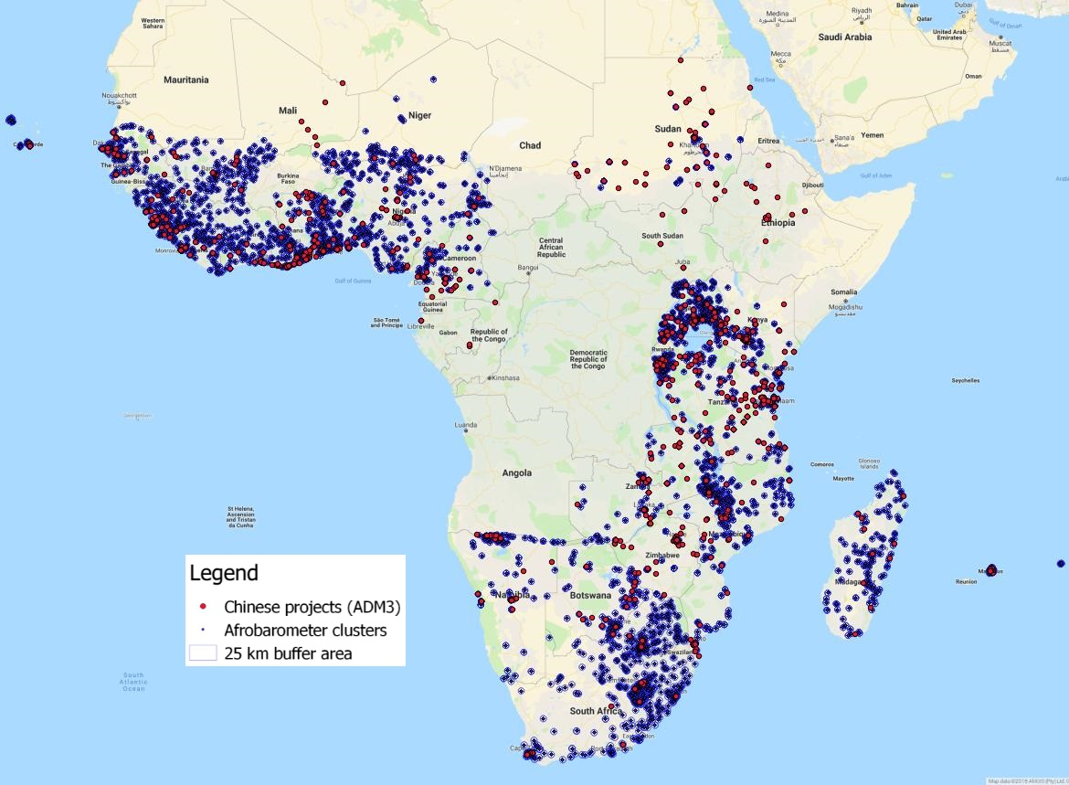
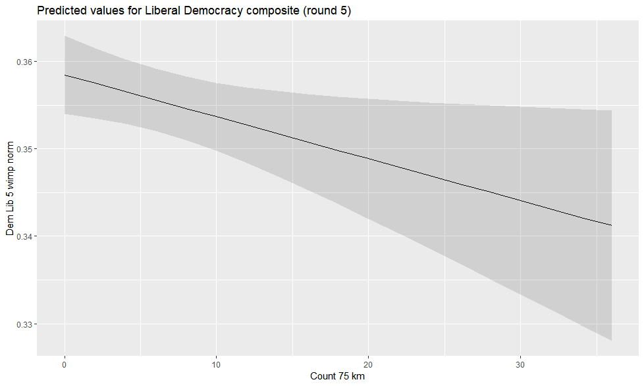
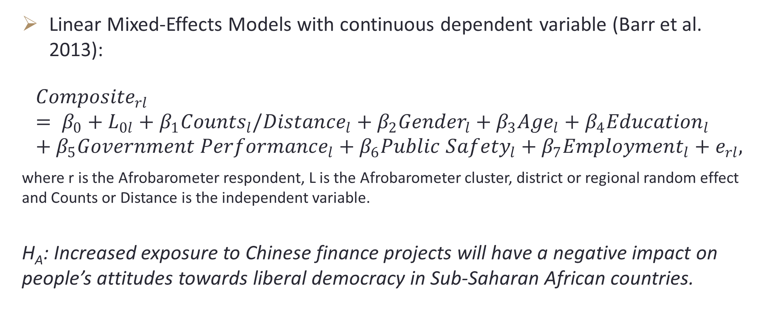
Paper 1: Chinese finance projects -> attitudes towards liberal-democracy in Africa [subnational level analysis]
Raluca-Maria Nicoara
background
methods
results
In Africa, between 2011 and 2015, the overall support for democracy has decreased by 7%, while the preference for non-democratic alternatives (such as one-party regimes) has increased with almost 2% (Mattes and Bratton 2016, p. 14).
Scholars, such as Diamond (2008, p. 37), have warned about the dangers represented by dissatisfied citizens who might “eventually lose faith and turn to authoritarian alternatives”, especially in a context where authoritarian powers, such as China are providing examples of alternative models of economically successful development (Ramo 2004; Li 2015).
Research question: What is the impact of increased economic linkages with China on attitudes towards liberal democracy in Sub-Saharan African countries?
Linear Mixed-Effects Models with continuous dependent variable (Barr et al. 2013):
$${Composite}_{rl}= β_{0}+L_{0l}+β_{1}{Counts}_{l}/{Distance}_{l}+β_{2}{Gender}_{l}+β_{3}{Age}_{l}+β_{4}{Education}_{l}+β_{5}{Government Performance}_{l}+β_{6}{Public Safety}_{l}+β_{7}{Employment}_{l}+e_{rl},$$
where r is the Afrobarometer respondent, L is the Afrobarometer cluster, district or regional random effect and Counts or Distance is the independent variable.
H_{A}: Increased exposure to Chinese finance projects will have a negative impact on people’s attitudes towards liberal democracy in Sub-Saharan African countries.
Multilevel models with the IV measured as counts and distance and Liberal-Democracy as DV (round 5), including 5 models out of 72 total models
Distribution of Liberal Democracy composite (DV) across districts/ADM2, round 6
Distribution of distances from the cluster to the closest Chinese project, Round 6
Variables
Dependent variable (DV), Public attitudes towards liberal democracy:
Composite index created by aggregating Afrobarometer survey data from round 5 and 6 with 28 countries;
I use MCMCfactanal() from the R package MCMCpack which computes the indices based on the Markov Chain Monte Carlo method with over 100 000 iterations and I check for convergence with the Heidelberger and Welch diagnostic
Normalized on a continuous scale from 0 to 1.
Independent variable (IV), Chinese finance projects measured as:
Counts of Chinese financed projects located at three administrative levels (ADM1/regional level, ADM2/district level and ADM3/cluster level) and buffer areas (25km, 50km and 75km buffers).
Distance from a Chinese project to the closest Afrobarometer cluster.
I used QGIS to geolocate the projects in order to compute counts and distances
Control variables:
Gender of respondent (binary, 0-male and 1-female),
Age of the respondent (continuous),
Education of respondent (categorical with 9 categories: 0=No formal schooling to 9=Post-graduate),
Government performance (categorical with 4 categories: 1=Very badly to 4=Very well),
Public safety (categorical with 5 categories (frequency of feeling unsafe): 0=Never to 4=Always),
Employment (categorical with 3 categories: 0=unemployed, 1=part time, 2=full time).
Distribution of Chinese projects (IV) across regions/ADM1
Distribution of Chinese projects (IV) and Afrobarometer clusters (DV)
 | Percentage of Chinese projects located at 25km (distance < 25km) | Percentage of Chinese projects located at 50km (distance < 50km) | Percentage of Chinese projects located at 75km (distance < 75km)
Round 5 | 43.36408% | 62.51065% | 73.76746%
Round 6 | 44.81582% | 63.11472% | 74.80164%
MCMC – R code
results
conclusions
Dem_rule6<-MCMCfactanal(~Gov_account_vertical_scaled+Free_elections_scaled+Parties_scaled+Term_limit_scaled,
factors = 1, lambda.constraints = list(),data = round6_without_imputed, burnin = 5000,
mcmc = 100000, thin = 100,verbose = 50000, seed = NA, lambda.start = NA, psi.start = NA,
l0=0, L0=0, a0=0.001, b0=0.001, store.scores=TRUE, std.var =TRUE)
capture.output(heidel.diag(Dem_rule6), file = "Dem_rule6_test.txt") # Heidelberger and Welch diagnostic
normalized <- function(y) {
x<-y[!is.na(y)]
x<-(x - min(x)) / (max(x) - min(x))
y[!is.na(y)]<-x
return(y)
} #This function is used to normalized the posterior probabilities on a countinuous scale from 0 to 1.
No strong evidence to reject the null hypothesis. This conclusion is warranted given that:
There is a high percentage of non-significant coefficients (47%) which means that in 34 models, there is no significant effect of the proximity to and counts of Chinese projects on attitudes towards liberal-democracy.
The direction/significance of the effect changes across the measurements and rounds which indicates no consistency in the results.
Even if in 18 models, I find a significant effect with the expected direction, the magnitude of the effect is small (an increased of 20 Chinese projects leads to a decrease of 0.01 in public support for liberal-democracy.
Possible explanations that might explain these non-results:
Empirical: issues with China data – dismissed as data used in the project is created based on media sources, verified and has been used in peer-reviewed papers.
Theoretical: not much difference between labor practices of Chinese and Western companies (Rounds and Huang 2017), thus it is possible that the presence of Chinese finance projects might not have a different impact compared to that of the Western companies.
Notes:
To change this poster, replace our sample content with your own. Or, if you'd rather start from a clean slate, use the New Slide button on the Home tab to insert a new page, then enter your text and content in the empty placeholders. If you need more placeholders for titles, subtitles or body text, copy any of the existing placeholders, then drag the new one into place.

